Slide 1

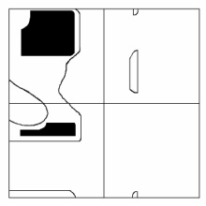
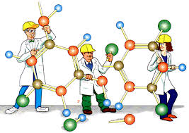
Homology Modeling and Molecular Docking
Dr. K. Gugan
Assistant Professor
CAS in Crystallography and Biophysics
University of Madras

Slide 2
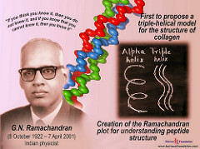
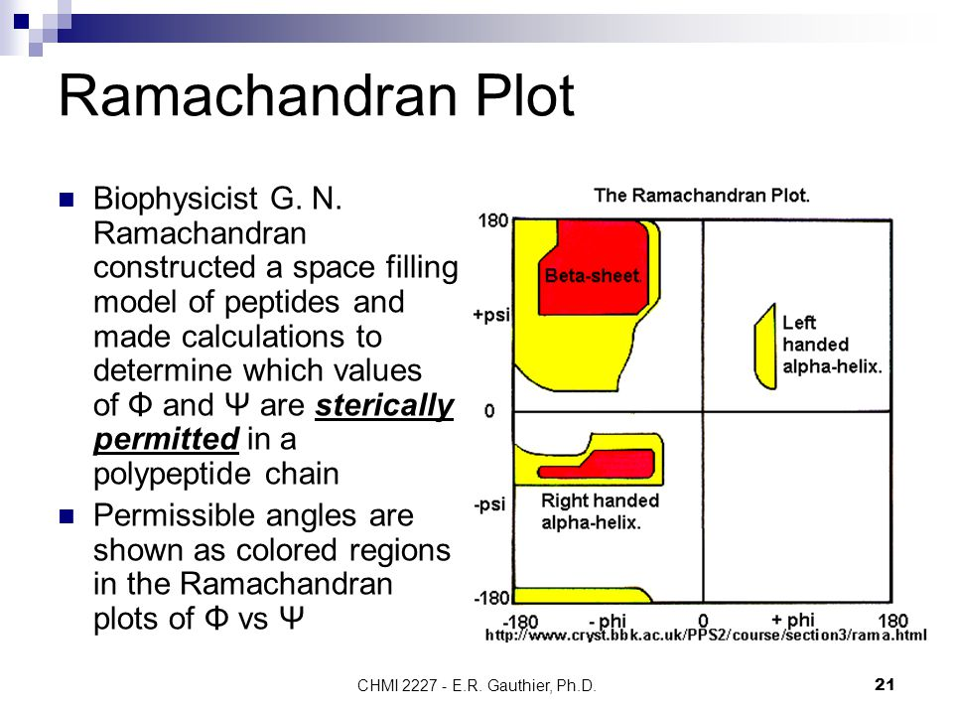
G.N. Ramachandran 8th of October 1922 – 7th of April, 2001

Slide 3
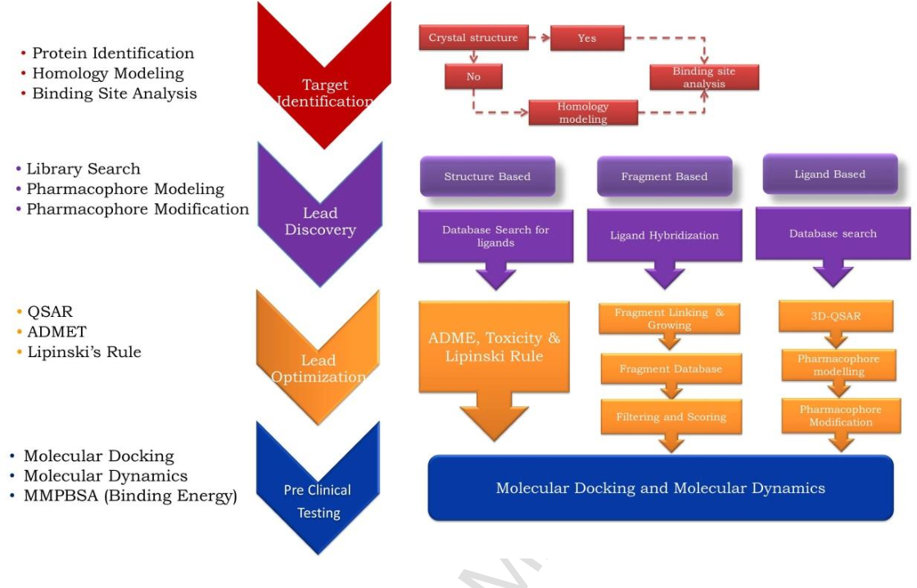
Computational Drug Discovery

Slide 4
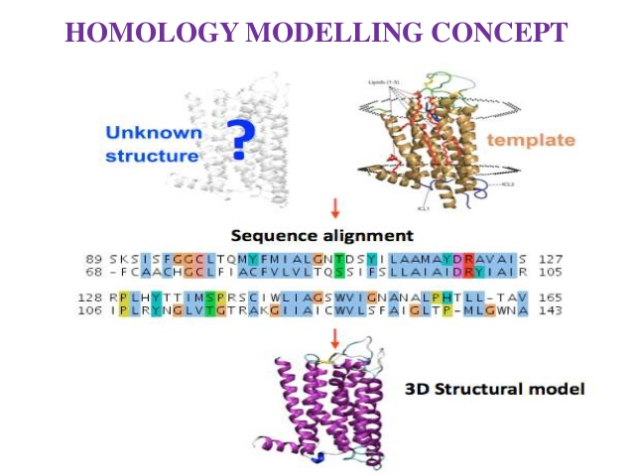
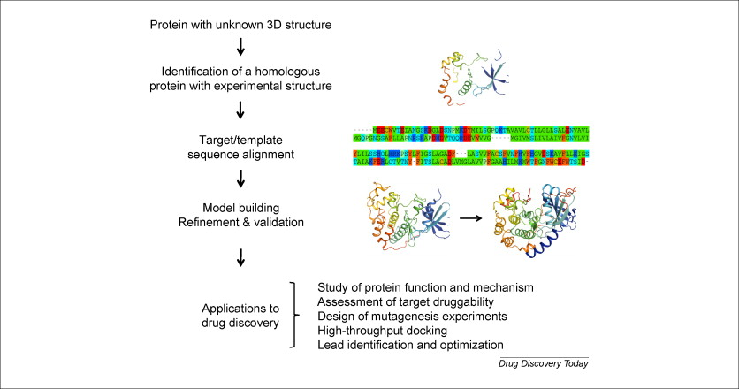
Homology Modeling

Slide 5
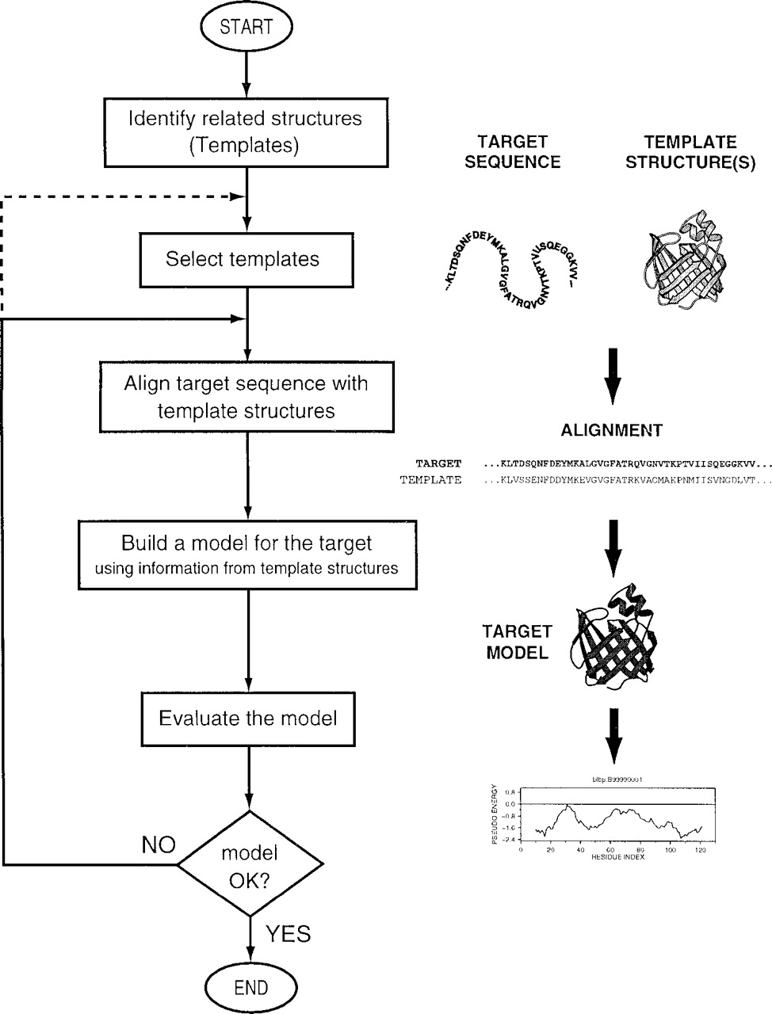
Steps in Comparative
Protein Structure
Modeling

Slide 6
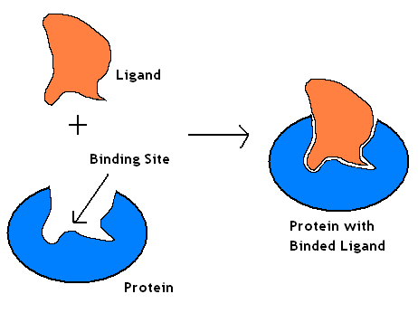
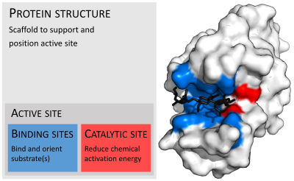
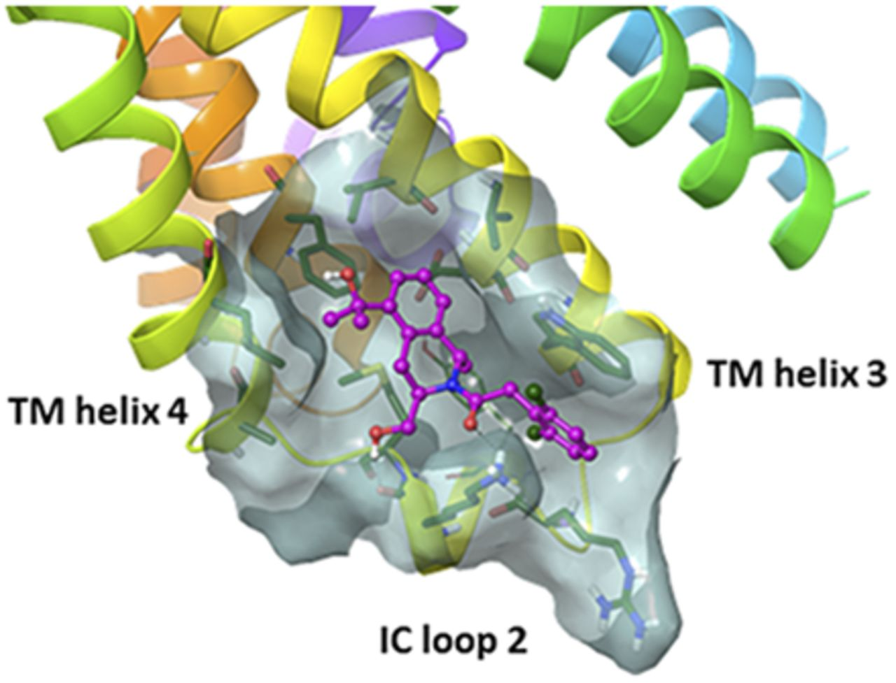
Binding Site

Slide 7
Docking & Scoring?
To place a ligand (small molecule) into the binding site of a receptor in the manners appropriate for optimal interactions with a receptor.
To evaluate the ligand-receptor interactions in a way that may discriminate the experimentally observed mode from others and estimate the binding affinity.
complex
ligand
docking
scoring
receptor
X-ray structure
& ΔG
… etc

Slide 8
Three Components of Docking
pre- and/or
during docking:
Representation of receptor
binding site and ligand
during docking:
Sampling of configuration space
of the ligand-receptor complex
during docking
and scoring:
Evaluation of ligand-receptor
interactions

Slide 9
Steps in Docking
Preparation of Macromolecule
Preparation of ligand
Preparation of Grid parameter file
Preparation of docking parameter file
Analysis of Results

Slide 10
Protein preparation - PDB
Protein Data Bank (PDB) is a crystallographic database for the three-dimensional structural data of large biological molecules, such as proteins and nucleic acids.
www.rcsb.org
www.ebi.ac.uk/pdbsum

Slide 11
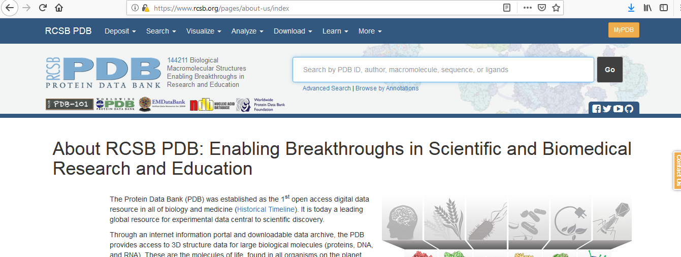
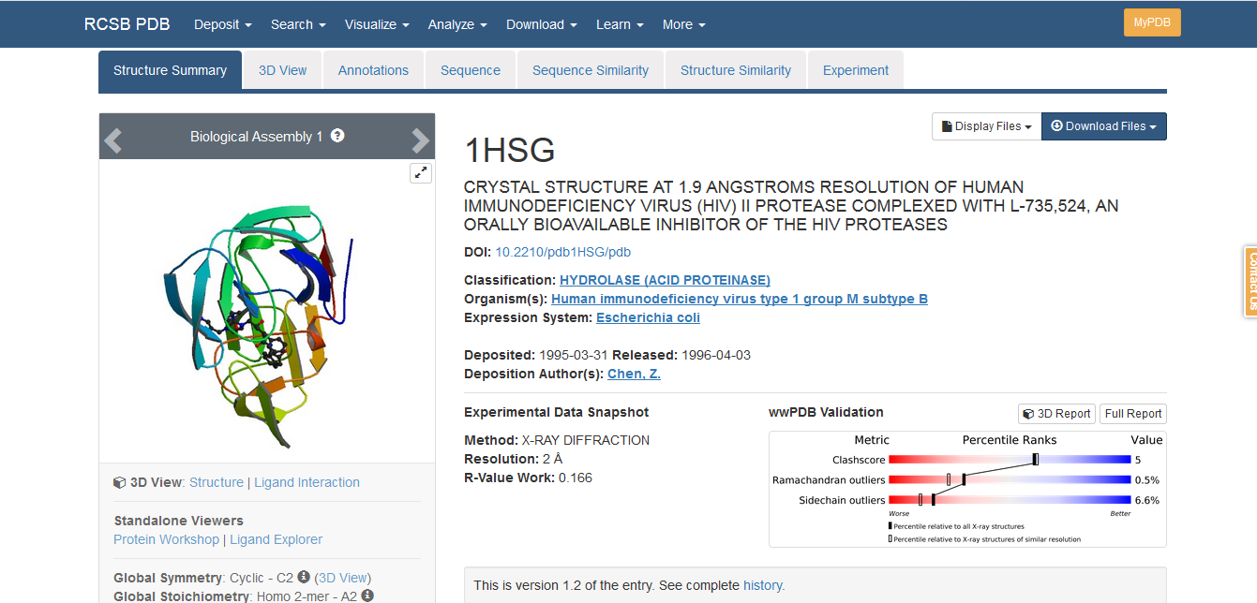

Slide 12
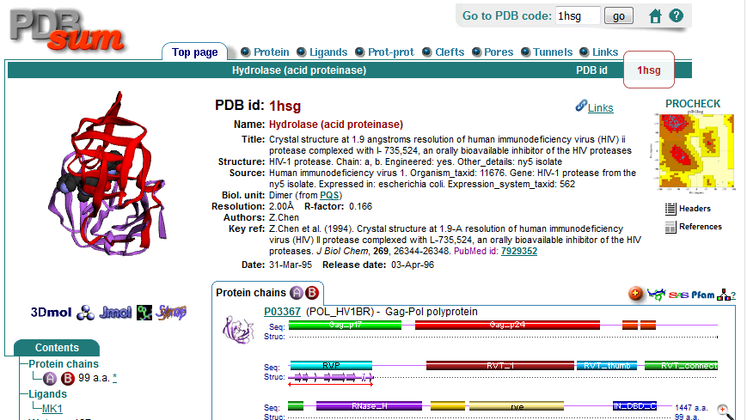

Slide 13
Protein preparation –Why?
The structures from PDB have variety of potential problem such as
missing side chain atoms,
added waters,
more than one molecule,
chain break.
so we need to corrected before it can be used.

Slide 14
Protein preparation –Steps
Delete ligands
Delete water molecules
Add hydrogens
Add charges
Assign to Atomtype
Save the molecule

Slide 15
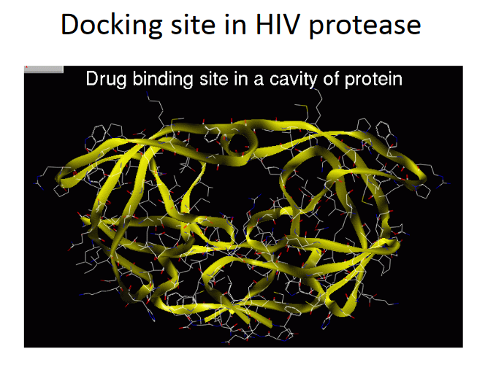

Slide 16
Ligand preparation

Slide 17
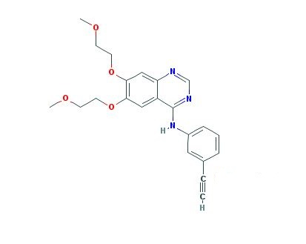
Building small molecules - Chemsketch
Drugbank
Pubchem
Chemspider

Slide 18
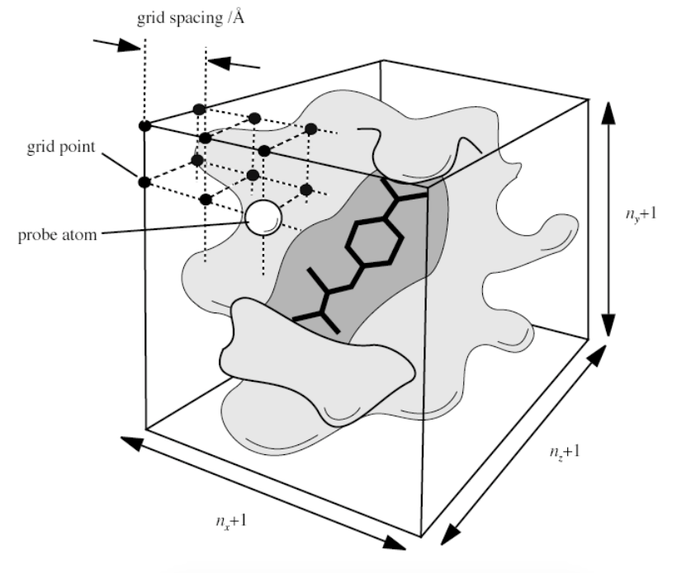
Why Use Grid Maps?
Saves time:
✽ Pre-computing the interactions on a grid is typically 100 times faster than traditional Molecular Mechanics methods
✽ O(N2) calculation becomes O(N)
✽ AutoDock uses trilinear interpolation
✽ to compute the score of a candidate docked ligand conformation
✽ AutoDock needs one map for each atom type in the ligand(s) and moving parts of receptor (if there are any)
✽ Drawback: The receptor is conformationally rigid (although ‘vdW softened’)
✽ Limits the search space

Slide 19
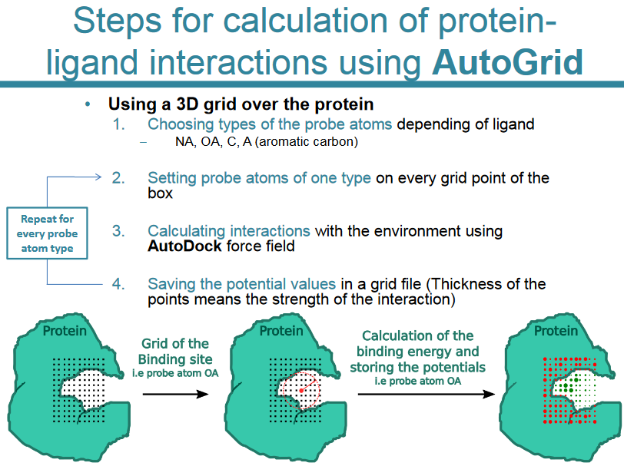

Slide 20
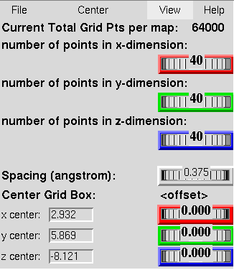
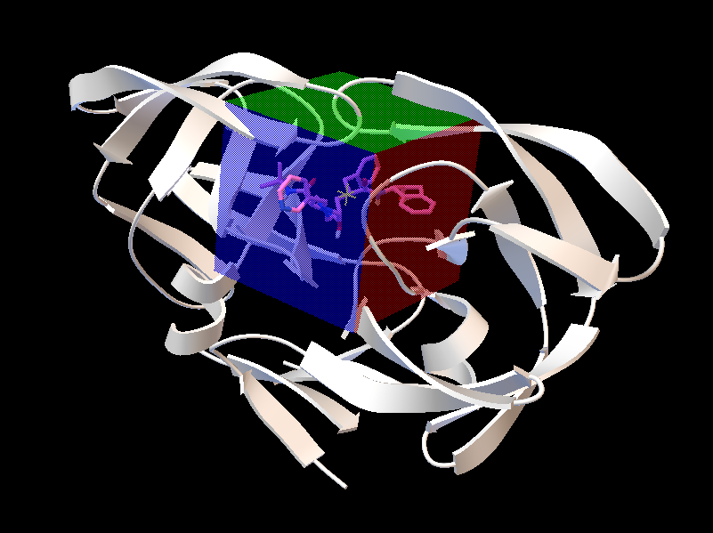

Slide 21


